Slide 1
Marketing Operations
Email Campaign Fundamentals
Bindhu L
3rd April 2024

Slide 2
Agenda
Welcome
Best Practice: Email Marketing Fundamentals Best Practices
Open Q&A/Discussion

Slide 3

Marketing Operations Open Office Hours
Get your questions answered by the marketing automation team. MA Open Office Hours are held monthly with the following agenda:
Learn about a tip or best practice
Ask a question – Pre-submit your questions here or ask during the office hours
Learn how to leverage IQVIA’s marketing systems and processes most effectively
Action: Sign up here, if you need to be added to the outlook invite
Reminder: Save your questions for the end or enter in the chat. We will address as many as we can!

Slide 4
Email marketing – general tips
Consider the timing between any resends
Concise, clear and compelling
Consider when to schedule for
Between a max of 30 and 60 characters
What is next after someone has completed your original CTA?
Scheduling
Use the preview text area
Subject
Line
Don’t schedule outreach campaigns close together
A/B testing and different styles
Keep the main message and CTA above the fold
If there are resends use different subject lines/content
Audience
Body Copy
Avoid being too copy heavy
Consider audience engagement, well targeted campaigns often have better performance
Use CTAs rather than links within copy
Consider personalization beyond just the subject line or salutation
Notes:
Optimise the email’s preview text
Keep the main message and call to action above the fold
A/B test different subject lines and calls to action
Write compelling (but concise) subject lines
Keep the body of the email simple and aim to grab your readers attention quickly. Avoid being too copy heavy where possible.
Consider when to schedule a campaign for – avoid Friday afternoons. Some research has shown that Tuesday mornings are one of the best times of the week with Thursday second and Wednesday third.
Personalise your emails – this goes beyond including a personalised salutation and can be as complex as dynamic content geared towards different segments
Avoid mailing mass audiences and aim to be more targeted – we often see better results for smaller more targeted audiences (sub 5000) rather than those mailed to over 10000
Avoid using hyperlinks and direct URLS in running text as tapping on these can be challenging on smaller screens – replace with CTAs

Slide 5
Subject line best practices
A successful email starts with a subject line that grabs the attention of your recipients and gives people a reason to check out your content
Concise and clear
Make it very clear what the email contains and leave no doubt what readers will find when they open it. Don’t over promise or mislead.
1
Keep it short
2
Mobile devices display lesser characters, keep your subject lines between 30 to 60 characters. Use the preview text as an extension to the subject line
Use personalisation
3
The more relevant and personal your email subject lines are, the higher your open rates will be
Avoid spam trigger words
4
i.e. 100%, free, open, sale, urgent
Consider different styles
5
i.e. communicating urgency, use questions to pique the interest, use numbers, A/B test
Notes:
It’s not just about the subject line - audience selection/targeting is also important and will impact your open rates
Use different subject lines for any type of re-sends

Slide 6
Subject line styles
Examples of different styles of subject lines
Style | Description | Example
Informational | Pertinent information is up front in subject lines | Gene editing live webinar: November 20
Personal | You can use personalisation such as the recipients firstname or you can make a post event email feel personal | Thanks for joining us, firstname Great to meet you at ISPOR last week
Urgent | People often respond to the possibility of losing out on something so create some urgency in the subject line | 2 days left to register! or Don’t miss out!
The list | Provides an opportunity to use numbers in the subject line | 3 ways to increase your., The 10 best…..
Question | Asking readers a question in the subject line can immediately engage them | What’s next for AI/ML?
How-to | Offers insight into the content/benefit for the readers | How to improve your research
Scarce | Similar to urgent and playing on the fact that people hate to miss out | AI/ML Webinar: Only a few spots remain
Command | using a command in your subject line tells the readers exactly what you want them to do | Join us in Boston, Subscribe to our monthly email

Slide 7
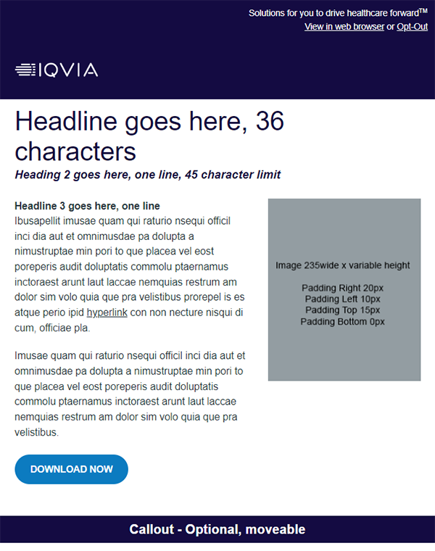
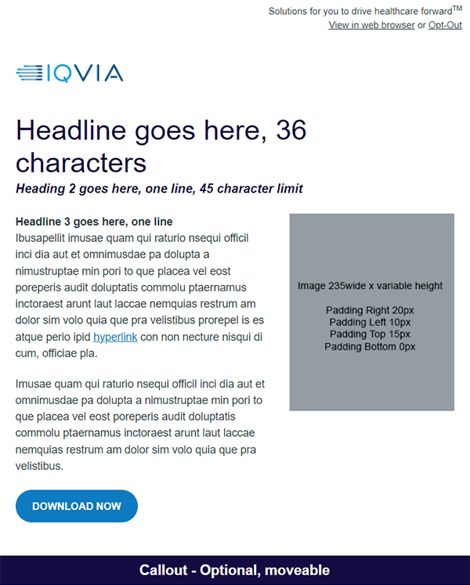
Working with Our Templates
Considerations for the templates
We have a suite of templates available in 2 different colors (Indigo and White)
You can download editable word versions on the Marketing Operations toolbox or on brandworld.
The character length limit for each section is detailed in the templates which can be downloaded in word version.
Brand approved images are available on brandworld
We also have the email banner generator tool available to create banner images
Provide a subject line and preview text when sending content across

Slide 8
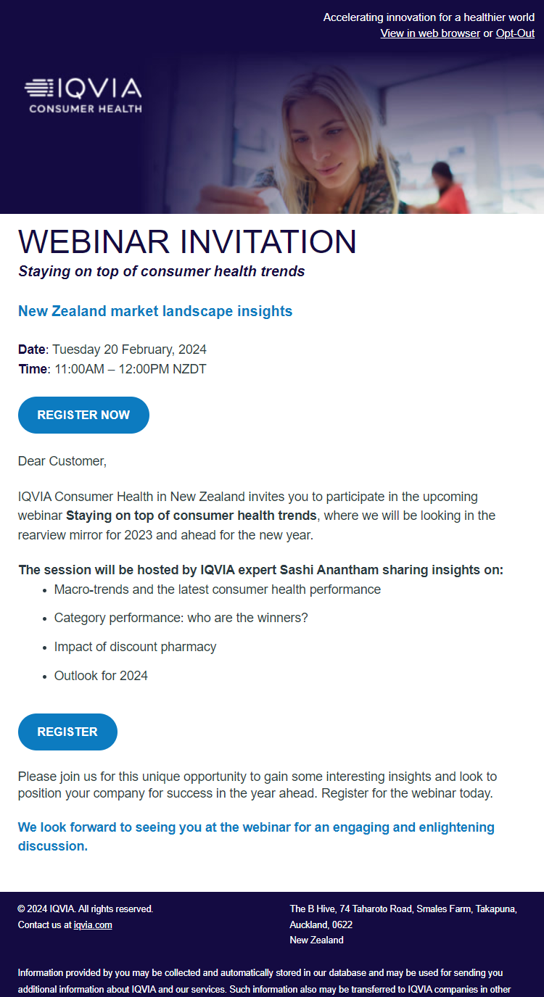
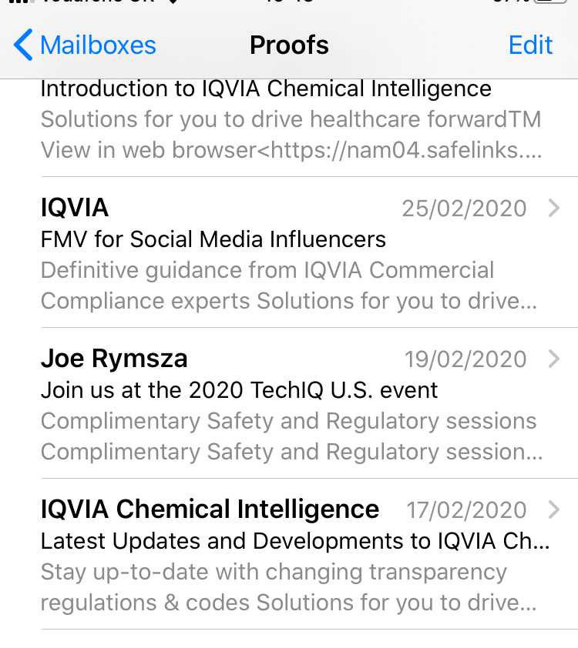
Tips on Email Content and Layout
Some general tips for email marketing campaigns
Main message/headline and CTA above the fold
Optimise the email’s preview text
Compelling concise subject lines
A/B testing
Concise agenda
Keep email body simple
Personalise from name/address
Clear CTA, avoid using hyperlinks and urls in text as these can be challenging on smaller screens

Slide 9
Outreach best practice
Provide as much detail within the request including segmentation requirements
When content is supplied it should be final and approved to avoid rounds of amends and should include subject line/preview text and all links
Any data supplied needs to include the mandatory fields – first name, last name, title, company, email address and country
Email will be created and a test sent
Test should be reviewed and only minor amends (if any) should be required
Segment will be created and confirmed
Once email is approved the campaign will be scheduled
Campaign start
(7-4 days before send)
Post-delivery
(7 days after send)
Planning
Campaign request
(at least 7 days before send)
Campaign finalized
(7-1 day before send)
Try and plan campaigns in advance
Avoid too many in the same week (i.e. no more than 2)
Submit outreach request as soon as possible – you don’t need to have all assets at the time of submission
Content is due 7 days before the send date
We have word versions of the email templates that can be used
Standard SLA is 7 days from receipt of content
SLAs can be found on the MA Toolbox and vary depending on campaign complexity
If content is delayed then the outreach may need to be re-scheduled accordingly
Results and click-through visualiser will be sent 1 week after send date
Campaign results can also be found within Salesforce

Slide 10






Common metrics and what they tell us
Open rates
Subject line quality & Audience
The number of times an email is opened as a percentage of delivery.
A unique open rate measures once per recipient rather than the total number
Click rates
Strength of CTAs
The number of times an email is clicked as a percentage of delivery.
A unique click rate measures once per recipient rather than the total number
Click to open rate
Engagement with content
This provides a percentage comparison of unique clicks by unique opens
Delivery rate
Data quality
Total emails delivered divided by the total emails sent.
Linked with bounce rate
Bounce rate
Data quality
The percentage of your total emails sent that could not be successfully delivered to the recipient's inbox.
Forward rate
This shows the total possible forwarders divided by the delivered volume. Provides an insight into how many people sent your email on to another person
Hard v Soft Bounces
A hard bounce is an email that permanently could not be delivered i.e. invalid email or domain
A soft bounce is an email that temporarily could not be delivered i.e. inbox full, mail server unavailable. Some soft bounces will be converted to a hard bounce after they bounce 3 times.

Slide 11
Common issues with email metrics
Problem
Reason
Solution
Ineffective subject line
Too many emails
Timing
Recipients no longer interested
Bounced addresses not filtered
Spam/junk
Consider your subject line, A/B testing, styles
Think about the frequency of your communications
Consider when you are sending
Review data for frequent non-openers
Review frequent soft-bouncers
Hard to identify, look at frequent non-openers
Low open rates
Low click rates
Content
Layout
CTA
Content should be relevant, not too copy heavy
Layout should be clear and align with purpose of email
Make sure there is a clear CTA, ideally ‘above the fold’
Low delivery rates
Bounced addresses not filtered
Overall data quality
Review data for frequent soft bounces
Review data regularly and cleanse where appropriate

Slide 12
Key Takeaways
Subject Lines
Consider the length, content and style
Use the preview text as an extension of the subject line
Body Copy
Follow the character length limits within the templates
Scheduling/timing
Think about the timing of your emails
Results/Metrics
Consider what your results are telling you and what actions might need to be taken

Slide 13
Thank You

